Slide 1
Exception Handling

Slide 2
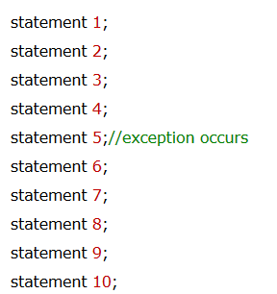
Introduction to Exception
Exception is an abnormal condition.
It is an exception is an event that disrupts the normal flow of the program. It is an object which is thrown at runtime.

Slide 3
Types of Java Exceptions
There are mainly two types of exceptions: checked and unchecked. Here, an error is considered as the unchecked exception. exceptions:
Checked Exception
Unchecked Exception
Error

Slide 4
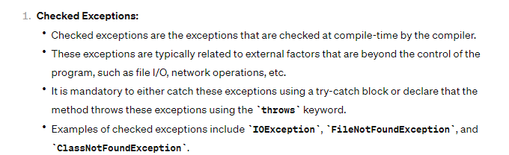
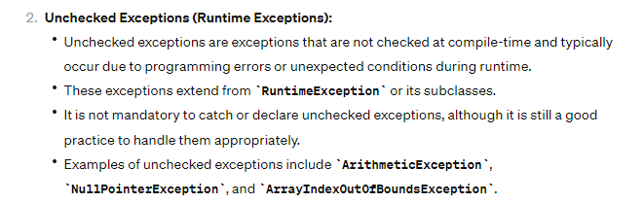

Slide 5
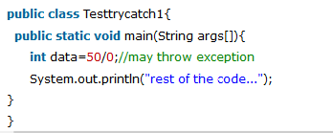

Slide 6
Common Scenarios of Java Exceptions
Case 1: int a=50/0;//ArithmeticException
Case 2:
String s=null;
System.out.println(s.length());//NullPointerException
Case 3:
String s="abc";
int i=Integer.parseInt(s);//NumberFormatException
Case 4:
int a[]=new int[5];
a[10]=50; //ArrayIndexOutOfBoundsException

Slide 7
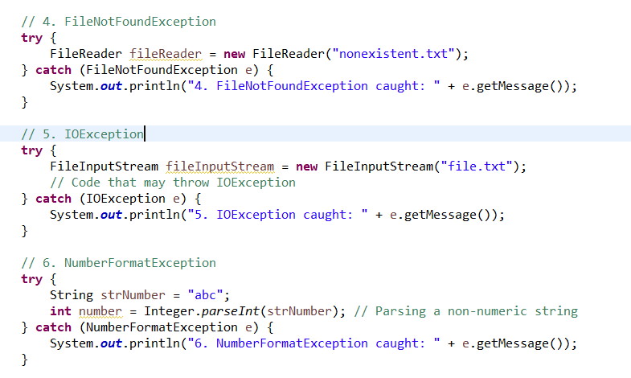

Slide 8

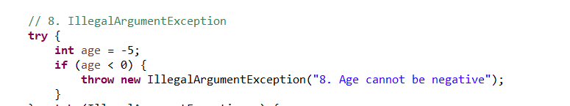

Slide 9
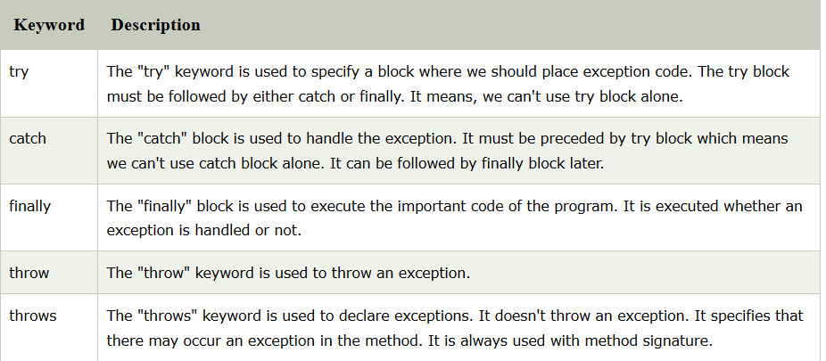
Java Exception Keywords

Slide 10
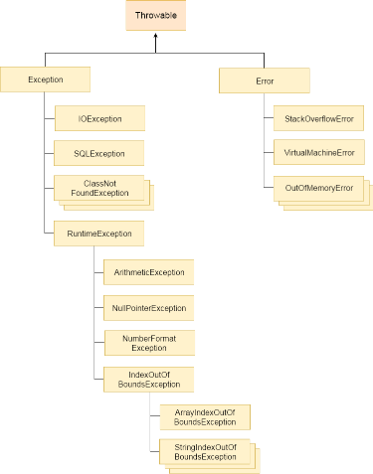

Slide 11
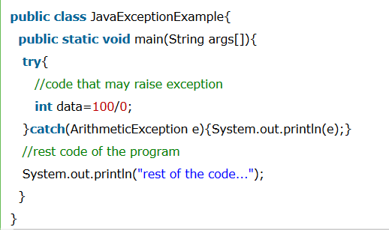
Example

Slide 12


try-catch

Slide 13
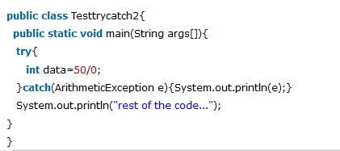

Slide 14
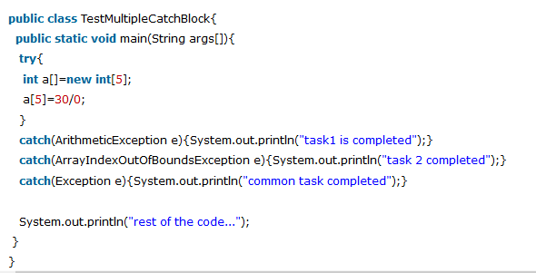
Java catch multiple exceptions

Slide 15
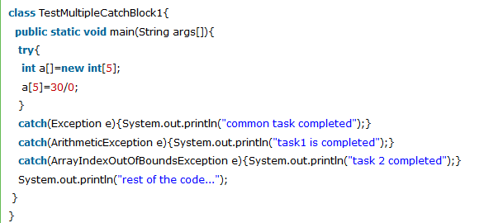
All catch blocks must be ordered from most specific to most general i.e. catch for ArithmeticException must come before catch for Exception

Slide 16
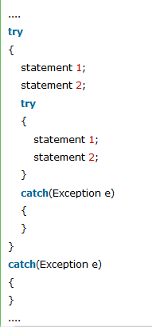
Nested try block

Slide 17
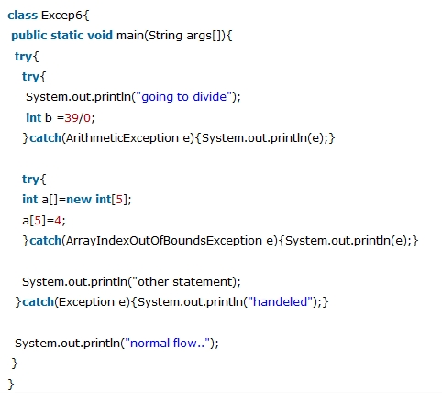

Slide 18
Java finally block
Java finally block is a block that is used to execute important code such as closing connection, stream etc.
Java finally block is always executed whether exception is handled or not.
Java finally block follows try or catch block.

Slide 19
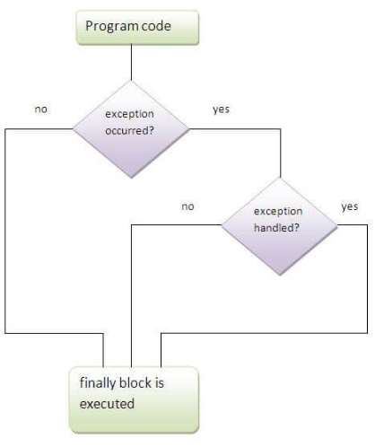

Slide 20
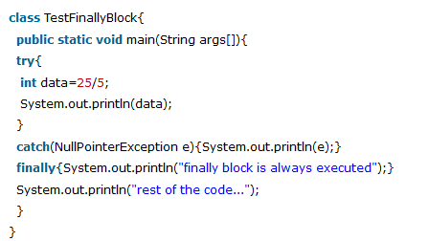
Case 1

Slide 21
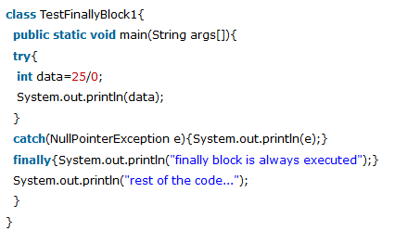
Case 2
exception occurs and not handled.

Slide 22
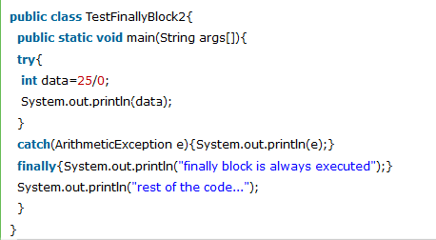
exception occurs and handled

Slide 23
throw exception
The Java throw keyword is used to explicitly throw an exception.
We can throw either checked or uncheked exception in java by throw keyword. The throw keyword is mainly used to throw custom exception.
throw exception;
throw new IOException("sorry device error);

Slide 24
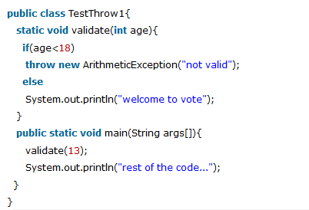
Ex

Slide 25
throws keyword
The Java throws keyword is used to declare an exception. It gives an information to the programmer that there may occur an exception so it is better for the programmer to provide the exception handling code so that normal flow can be maintained.
Exception Handling is mainly used to handle the checked exceptions.
If there occurs any unchecked exception such as NullPointerException, it is programmers fault that he is not performing check up before the code being used.

Slide 26
syntax
return_type method_name() throws exception_class_name{
//method code
}

Slide 27
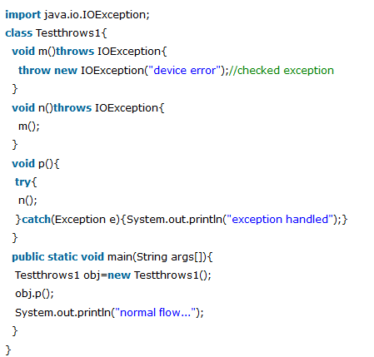
ex

